Slide 1
AI in Social Engineering and Phishing Campaigns
Presented by:
Sajid Khan
Aaquib Dabir
Gazi Khan

Slide 2
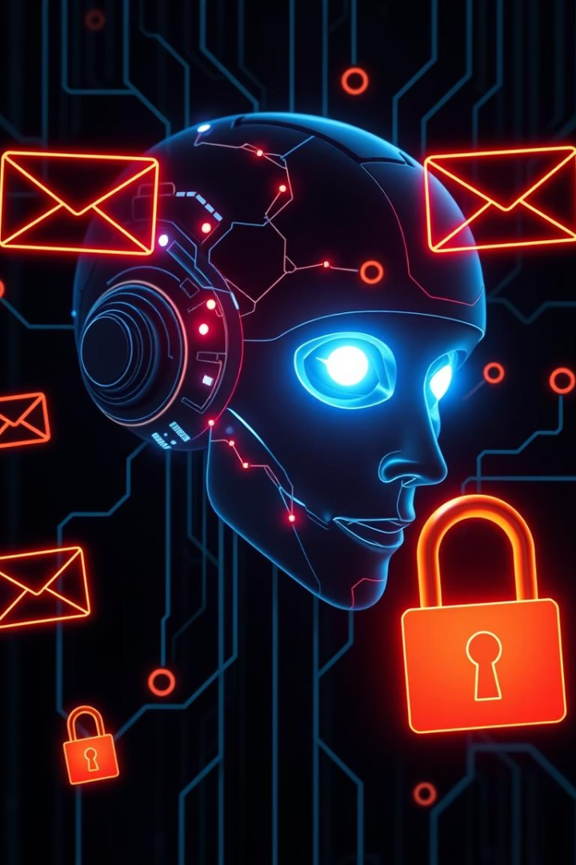
AI in Social Engineering and Phishing Campaigns
Phishing attacks are among the most common and dangerous forms of cybercrime, exploiting human psychology rather than system vulnerabilities. With the rise of AI, attackers now use machine learning to craft highly convincing fake emails, clone websites, and automate message delivery at scale. This project explores how AI is influencing social engineering and phishing attacks — and how defenders can leverage AI to detect and stop them.
XK

Slide 3

The Problem with AI-Powered Phishing
Rapid Fake Sites
Advanced Tricks
New phishing websites appear
quickly to avoid detection.
Fake messages sound real and use personal details.
Old security tools like spam filters and blacklists aren’t good enough to stop today’s AI-powered phishing attacks. These attacks can:Write fake messages that sound real,Create new fake websites quickly to avoid detection,Trick specific people by using personal details.Because of this, many people and companies are still at risk. We need smarter systems that can catch these advanced phishing tricks before they cause harm.

Slide 4
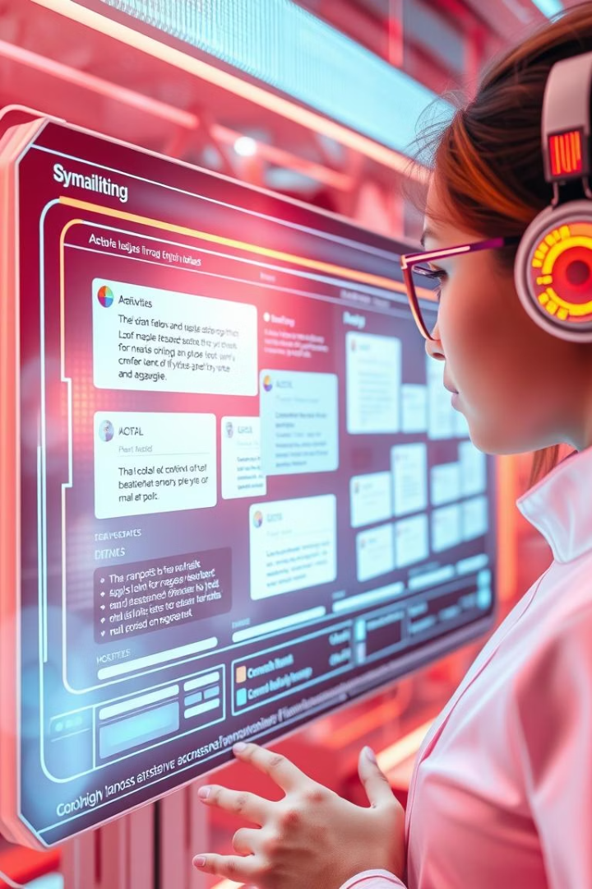
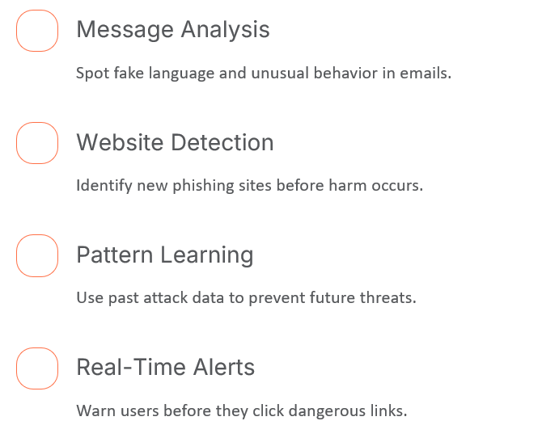
AI-Powered Defense Solutions

Slide 5
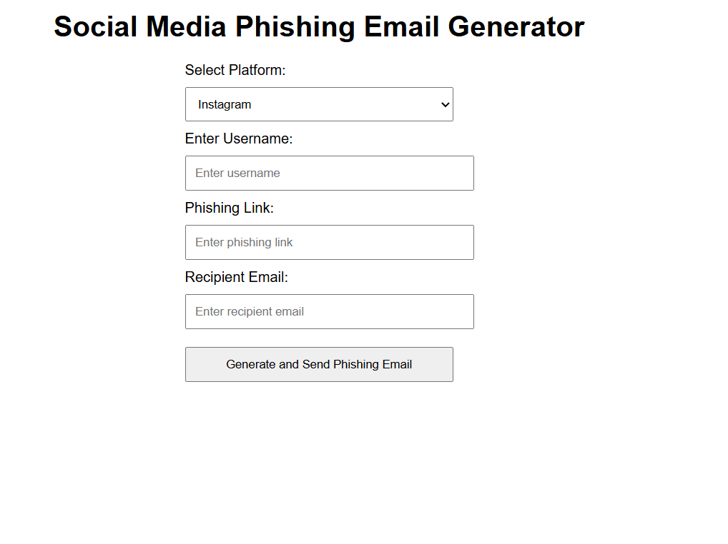
Phishing Email Simulation Tool
Purpose
Components
Ethics
Demonstrates how attackers craft targeted phishing emails.
Example:
Flask web app for input
Use only in controlled, educational environments.
Email generator with urgency and personalization
Simulated email sending

Slide 6
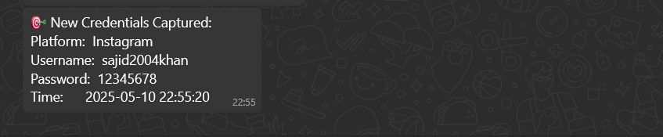
Phishing Log Monitor & WhatsApp Alert
Purpose
Components
Security
Automates credential capture and alert via WhatsApp.
Example:
Log file monitor extracts credentials
Use mocks and avoid real data for safety.
Twilio API sends alerts
Simulates real-time phishing operations

Slide 7
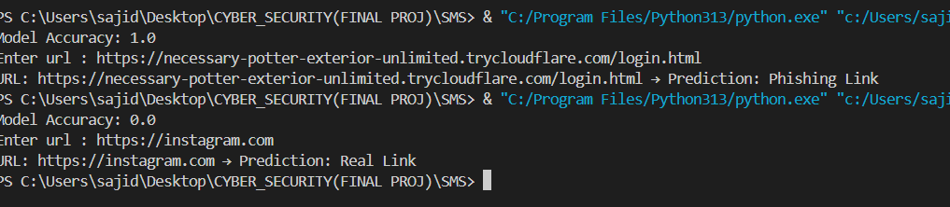
URL Phishing Detection Model
How It Works
Training
Prediction
Extracts URL features like length and suspicious words.
Example:
Random Forest classifier learns from labeled URL data.
Classifies URLs as phishing or real quickly and accurately.

Slide 8






Real-World Use Cases
Enterprise Security
Banking
Filter phishing emails and block malicious links.
1
Detect fake URLs and alert customers in real time.
2
Government
6
Social Media
Protect official sites and prevent fake alerts.
Identify fake profiles and block phishing bots.
3
Consumer Protection
5
E-Commerce
4
Browser extensions and apps warn users of phishing.
Spot fake sites and prevent transaction fraud.

Slide 9




Future Enhancements & Conclusion
Advanced Models
Use deep learning and transfer learning for better detection.
Secure Exfiltration
Implement encryption and multi-channel alerts.
Social Engineering
Personalize phishing emails with AI and automate campaigns.
AI both empowers phishing attacks and strengthens defenses. Smarter AI tools are key to safer digital spaces.

